Slide 1
ASAPP ONE DAY HACKATHON
Abdul Kadher P - 21L201
Adhil Hamdan R I - 21L202
Harini K M - 21L219
Lanka Nayanika - 21L225
Dharsha R - 21L239

Slide 2
System Architecture
Document Processing Pipeline
Input File Types: PDF, DOCX, CSV.
Text Extraction: PyPDF2, python-docx, pandas for text extraction.
Text Chunking: Splitting large texts into smaller, manageable pieces.
Information Retrieval
TF-IDF: Measures relevance between user question and document chunks.
Relevant Chunk Selection: Cosine similarity helps identify the most useful text segment for answering the question.

Slide 3
Model and Question Answering
Pre-trained Model:
DistilBERT: A smaller version of BERT optimized for performance and efficiency.
Pipeline Usage: Hugging Face’s pre-trained models are used for question-answering tasks.
Workflow:
User Uploads a File.
System Chunks the Document.
User Asks a Question.
TF-IDF Identifies the Most Relevant Chunk.
DistilBERT Generates the Answer.

Slide 4
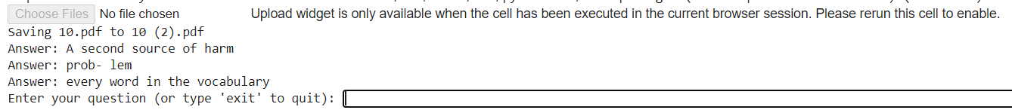

Slide 5
FRONT END
In the front-end development of the project, we have implemented a user-friendly interface using HTML, CSS, and JavaScript to manage file uploads and dynamically handle user questions related to uploaded research papers. Here's a brief explanation of the core components:
File Upload Section:
We created a form that allows users to upload PDF or DOCX research papers.
Once uploaded, the file is processed, and the system is ready to handle questions related to the document.
Question Submission:
Users can ask questions using a modal pop-up. We implemented a button that triggers the modal, allowing users to submit questions related to the uploaded paper.
After submission, the question is added dynamically to a list of questions.
Answer Submission:
Each question has an associated answer section, where users or other respondents can submit answers. These answers are displayed in real-time below the question.
Styling:
We've styled the layout using CSS, keeping the design clean and intuitive with a two-column structure. One side handles the file upload and displays questions, while the other side is used for submitting questions.

Slide 6
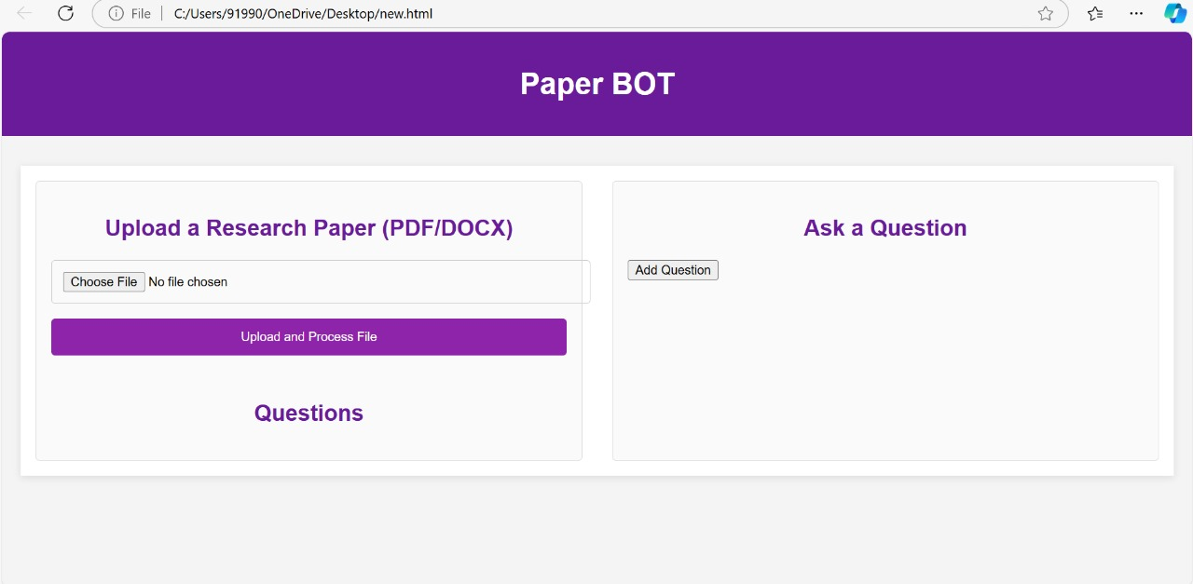

Slide 7
